Slide 1
Creating HTML Forms

Slide 2
The HTML <form> Elements
The HTML <form> element can contain one or more of the following form elements:
<input>
<label>
<select>
<textarea>
<button>
<fieldset>
<legend>
<datalist>
<output>
<option>
<optgroup>

Slide 3
The <form> Element
<form> . form elements . </form>
The <form> element is a container for different types of input elements,
such as: text fields, checkboxes, radio buttons, submit buttons, etc.

Slide 4
HTML <form> action Attribute
The action attribute specifies where to send the form-data when a form is submitted.
<form action="URL">
URL | Where to send the form-data when the form is submitted. Possible values: An absolute URL - points to another web site (like action="http://www.example.com/example.htm") A relative URL - points to a file within a web site (like action="example.htm")

Slide 5
The <input> Element The HTML <input> element is the most used form element. An <input> element can be displayed in many ways, depending on the type attribute.
Type | Description
<input type="text"> | Displays a single-line text input field
<input type="radio"> | Displays a radio button (for selecting one of many choices)
<input type="checkbox"> | Displays a checkbox (for selecting zero or more of many choices)
<input type="submit"> | Displays a submit button (for submitting the form)
<input type="button"> | Displays a clickable button

Slide 6
Text Fields The <input type="text"> defines a single-line input field for text input
The <label> Element
The <label> tag defines a label for many form elements.
The <label> element is useful for screen-reader users, because the screen-reader will read out loud the label when the user focus on the input element.

Slide 7
<html>
<body>
<h2>HTML Forms</h2>
<form action="/action_page.php">
<label for="fname">First name:</label><br>
<input type="text" id="fname" name="fname" value="John"><br>
<label for="lname">Last name:</label><br>
<input type="text" id="lname" name="lname" value="Doe"><br><br>
<input type="submit" value="Submit">
</form>
<p>If you click the "Submit" button, the form-data will be sent to a page called "/action_page.php".</p>
</body>
</html>

Slide 8
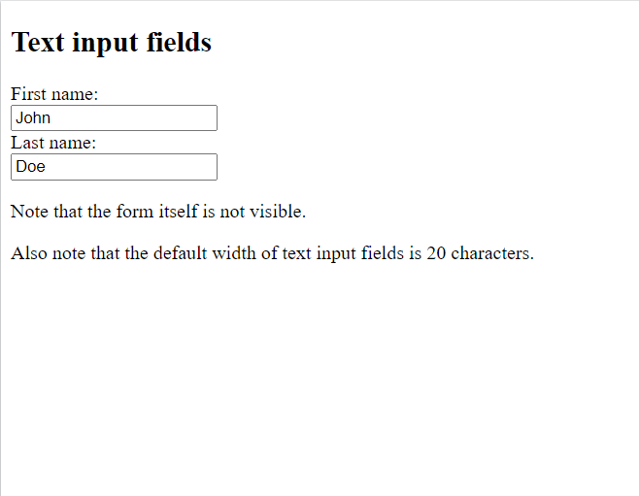
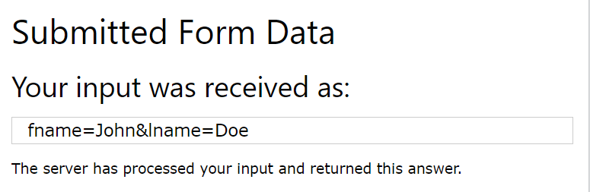

Slide 9
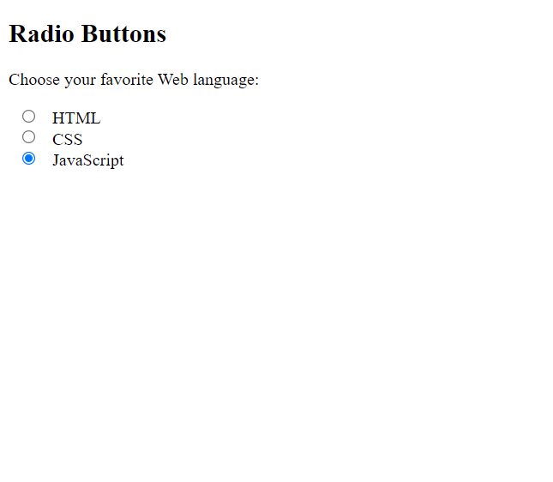
Radio Buttons
The <input type="radio"> defines a radio button.
<html>
<body>
<h2>Radio Buttons</h2>
<p>Choose your favorite Web language:</p>
<form>
<input type="radio" id="html" name="fav_language" value="HTML">
<label for="html">HTML</label><br>
<input type="radio" id="css" name="fav_language" value="CSS">
<label for="css">CSS</label><br>
<input type="radio" id="javascript" name="fav_language" value="JavaScript“ checked>
<label for="javascript">JavaScript</label>
</form>
</body>
</html>

Slide 10
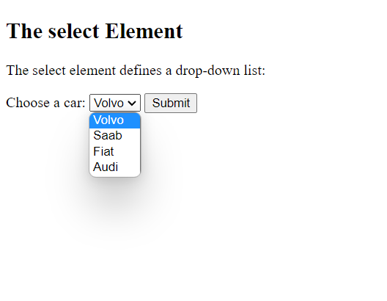
Select element:
The <select> element defines a drop-down list:
<html>
<body>
<h2>The select Element</h2>
<p>The select element defines a drop-down list:</p>
<form action="/action_page.php">
<label for="cars">Choose a car:</label>
<select id="cars" name="cars">
<option value="volvo">Volvo</option>
<option value="saab">Saab</option>
<option value="fiat">Fiat</option>
<option value="audi">Audi</option>
</select>
<input type="submit">
</form>
</body>
</html>

Slide 11
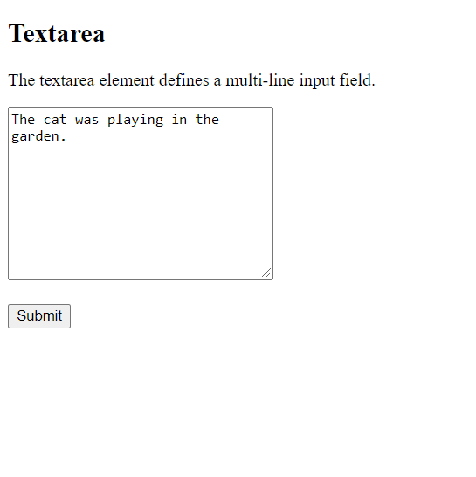
<html>
<body>
<h2>Textarea</h2>
<p>The textarea element defines a multi-line input field.</p>
<form action="/action_page.php">
<textarea name="message" rows="10" cols="30">The cat was playing in the garden.</textarea>
<br><br>
<input type="submit">
</form>
</body>
</html>

Slide 12
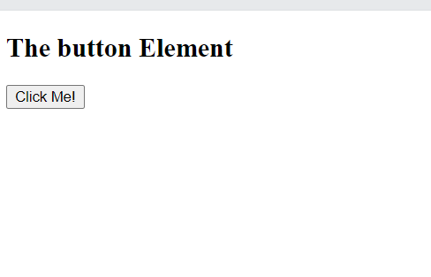
<html>
<body>
<h2>The button Element</h2>
<button type="button" onclick="alert('Hello World!')">Click Me!</button>
</body>
</html>

